Slide 1
Gamma distribution
Instructor: Santosh Chhatkuli

Slide 2
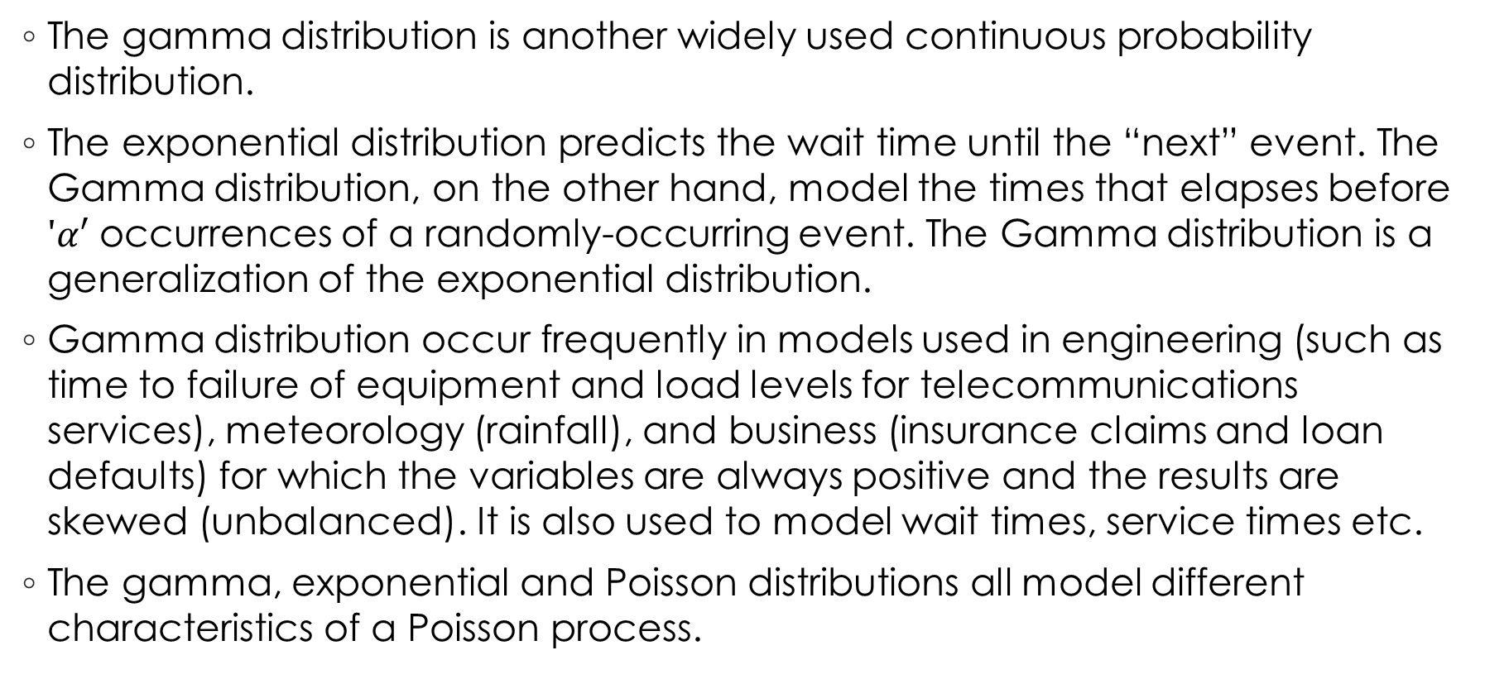
Introduction
The gamma distribution is another widely used continuous probability distribution.
The exponential distribution predicts the wait time until the “next” event. The Gamma distribution, on the other hand, model the times that elapses before $'α′$ occurrences of a randomly-occurring event. The Gamma distribution is a generalization of the exponential distribution.
Gamma distribution occur frequently in models used in engineering (such as time to failure of equipment and load levels for telecommunications services), meteorology (rainfall), and business (insurance claims and loan defaults) for which the variables are always positive and the results are skewed (unbalanced). It is also used to model wait times, service times etc.
The gamma, exponential and Poisson distributions all model different characteristics of a Poisson process.

Slide 3
Uses
The gamma distribution can be used a range of disciplines including queuing models, climatology, and financial services. Examples of events that may be modelled by gamma distribution include:
The amount of rainfall accumulated in a reservoir
The size of loan defaults
The aggregate insurance claims or different patterns of insurance claims
The flow of items through manufacturing and distribution processes
The load on web servers

Slide 4

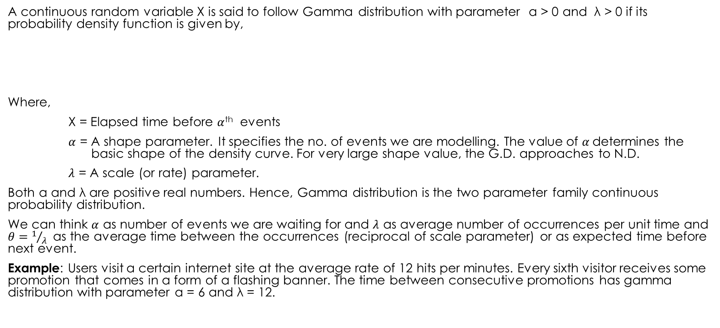
Probability density function of Gamma distribution
A continuous random variable X is said to follow Gamma distribution with parameter α > 0 and λ > 0 if its probability density function is given by,
Where,
X = Elapsed time before $α$^{th} events
$α$ = A shape parameter. It specifies the no. of events we are modelling. The value of $α$determines the basic shape of the density curve. For very large shape value, the G.D. approaches to N.D.
$λ$ = A scale (or rate) parameter.
Both α and λ are positive real numbers. Hence, Gamma distribution is the two parameter family continuous probability distribution.
We can think $α$ as number of events we are waiting for and $λ$ as average number of occurrences per unit time and $θ=1/λ$as the average time between the occurrences (reciprocal of scale parameter) or as expected time before next event.
Example: Users visit a certain internet site at the average rate of 12 hits per minutes. Every sixth visitor receives some promotion that comes in a form of a flashing banner. The time between consecutive promotions has gamma distribution with parameter α = 6 and λ = 12.

Slide 5

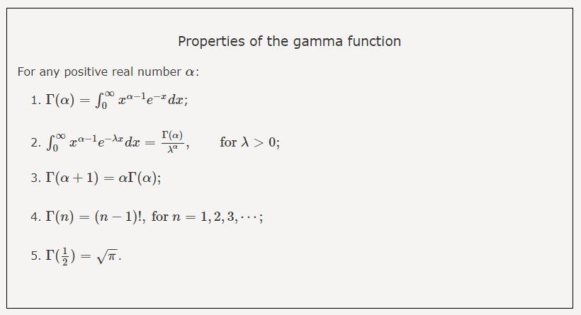
Gamma function
The gamma function is given by,

Slide 6
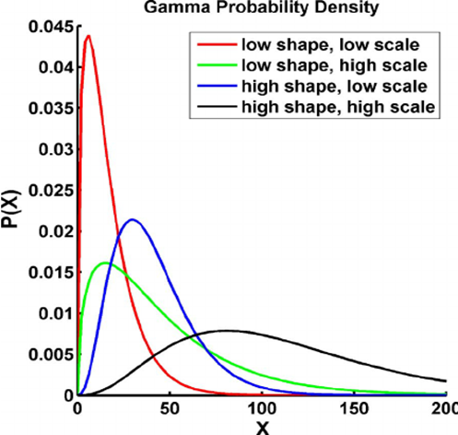
Shape of the Gamma distribution
The parameters α and λ define the shape of the graph. The change in λ will have more effect on the shape the distribution than change in α (the parameter λ has the effect of stretching or compressing the range of the Gamma distribution)

Slide 7

Special case of Gamma distribution
When α =1, the gamma distribution becomes exponential distribution. Thus Gamma (1, λ ) = Exponential ( λ). More generally, if we sum n independent exponential distribution (λ ) random variables, then we will get a gamma distribution ( n, λ)
Chi-square distribution is another probability distribution as a special case of Gamma distribution. When λ = ½, then gamma distribution converges to chi-square distribution with 2α degrees of freedom. Thus Gamma ( α, λ = ½) = Chi-square (2 α)
When λ = 1, then the gamma distribution is called standard gamma distribution which has the pdf of,

Slide 8


Another form of Gamma distribution
In some formula, the reciprocal of $λ$is used. Then the alternative form of probability density function of gamma distribution is given by,

Slide 9
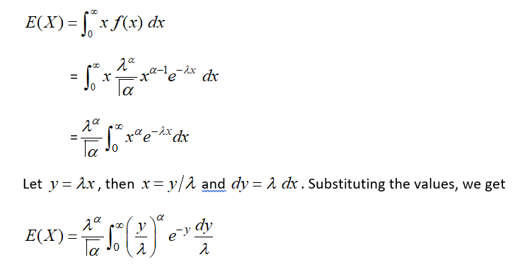
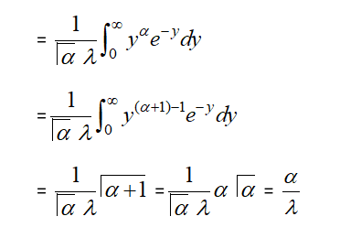
Mean of Gamma distribution

Slide 10
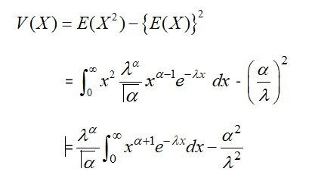
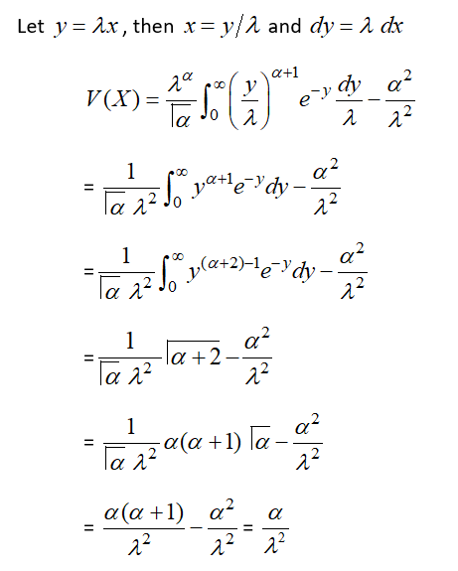
Variance of Gamma distribution

Slide 11
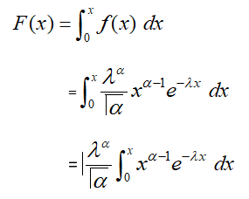
Cummulative distribution function of Gamma distribution

Slide 12
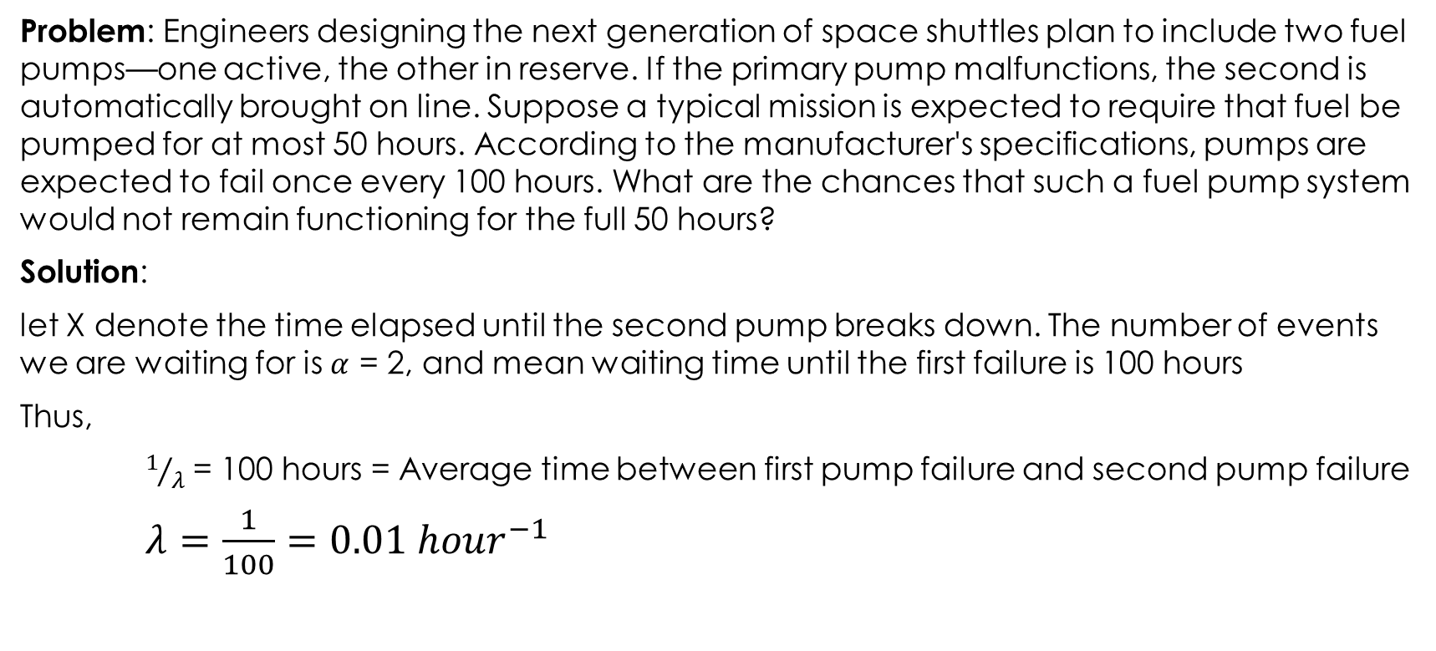
Numerical example
Problem: Engineers designing the next generation of space shuttles plan to include two fuel pumps—one active, the other in reserve. If the primary pump malfunctions, the second is automatically brought on line. Suppose a typical mission is expected to require that fuel be pumped for at most 50 hours. According to the manufacturer's specifications, pumps are expected to fail once every 100 hours. What are the chances that such a fuel pump system would not remain functioning for the full 50 hours?
Solution:
let X denote the time elapsed until the second pump breaks down. The number of events we are waiting for is $α$ = 2, and mean waiting time until the first failure is 100 hours
Thus,
$1/λ$ = 100 hours = Average time between first pump failure and second pump failure
$λ=\frac{1}{100}=0.01 {hour}^{−1}$

Slide 13
